Slide 1
Week #7 Linked Lists
Data Structure

Slide 2
What’s wrong with Array and Why lists?
Disadvantages of arrays as storage data structures:
  Sequential
  Identical ( same type)
  Fixed size
  In an unordered array, searching is slow, whereas in an ordered array, insertion is slow. In both kinds of arrays, deletion is slow
  Some time wasting space
  Linked lists can solve some of these problems

Slide 3
Array vs Linked List
node
node
Array
node
Linked List

Slide 4
Why linked list?
Linked lists are probably the second most commonly used general purpose storage structures after arrays.
It can also replace an array as the basis for other storage structures such as stacks and queues.

Slide 5
Cont..
Linked lists aren't the solution to all data storage problems, but they are surprisingly versatile and conceptually simpler than some other popular structures such as trees.

Slide 6
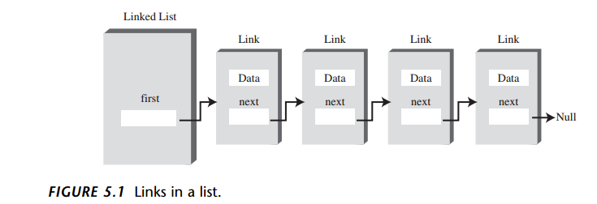
Anatomy of a linked list
A linked list consists of:
  A sequence of nodes
  Each node contains a value, and a link (pointer or reference) to some other node.
  The last node contains a null link.
  The list may (or may not) have a header

Slide 7
Linked Lists
Each data item is embedded in a link. and each Link object contains a reference to the next link in the list of items.
In an array items have a particular position, identified by its index whereas, in a list the only way to access an item is to traverse the list

Slide 8
More terminology
A link’s successor is the next link in the sequence
  The last link has no successor
A link’s predecessor is the previous link in the sequence
  The first link has no predecessor
A list’s length is the number of elements in it
  A list may be empty (contain no elements)

Slide 9
Here’s part of the definition of a class Link. It contains some data and a reference to the next link:
class Link
{
public inventoryItem iI; // object holding data
public Link next; // reference to next link
}
class Link
{
public int iData; // data
public double dData; // data
public Link next; // reference to next link
}
Notes:
We show only two data items in the link: an int and a double. In a typical application there would be many more. A personnel record, for example, might have name,
address, Social Security number, title, salary, and many other fields

Slide 10
How References Work
The next field of type Link is only a reference to another link, not an object. 1
A reference is a number that refers to an object. It's the object's address in the computer's memory, but you don't need to know its value. A reference tells you where the object is.
Link someLink = new Link();
Link aLink = someLink;
Notes:
Being able to put a field of type Link inside the class definition of this same type may seem odd. Wouldn’t the compiler be confused? How can it figure out how big to
make a Link object if a link contains a link and the compiler doesn’t already know how big a Link object is?
In a given computer/operating system, all references, no matter what they refer to, are the same size. Thus, it’s no problem for the compiler to figure out how big this field should be and thereby construct an entire Link object.

Slide 11
How References Work
Relationship, Not Position
Let’s examine one of the major ways in which linked lists differ from arrays. In an
array each item occupies a particular position. This position can be directly accessed using an index number. It’s like a row of houses: You can find a particular house using its address
In a list the only way to find a particular element is to follow along the chain of
elements. It’s more like human relations. Maybe you ask Harry where Bob is. Harry doesn’t know, but he thinks Jane might know, so you go and ask Jane. Jane saw Bob eave the office with Sally, so you call Sally’s cell phone. She dropped Bob off at Peter’s office, so…but you get the idea. You can’t access a data item directly; you must use relationships between the items to locate it. You start with the first item, go to the second, then the third, until you find what you’re looking for.

Slide 12
Pointers and references
In C and C++ we have “pointers,” while in Java we have “references”
  These are essentially the same thing
    The difference is that C and C++ allow you to modify pointers in arbitrary ways, and to point to anything
  In Java, a reference is more of a “black box,” or ADT.
  There are constraints on what kind of thing is referenced: for example, a reference to an array of int can only refer to an array of int

Slide 13
Operations in a simple linked list:
Insertion (insert a new data Item)
Deletion (delete a data item with a specified key).
Searching or Iterating through the list to display items.
Review the Link-List Workshop applet

Slide 14
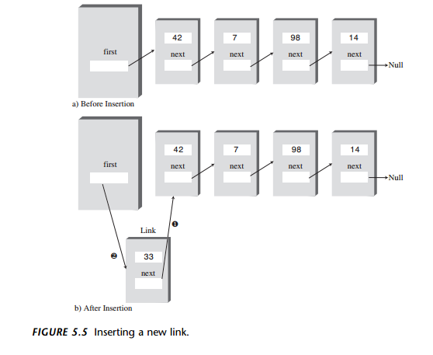
The Insert
public void insertFirst(int id, double dd)
{ // make new link
Link newLink = new Link(id, dd);
newLink.next = first; // newLink --> old first
first = newLink; // first --> newLink
}
Notes:
https://www.youtube.com/watch?v=k02S1MtTxO4

Slide 15
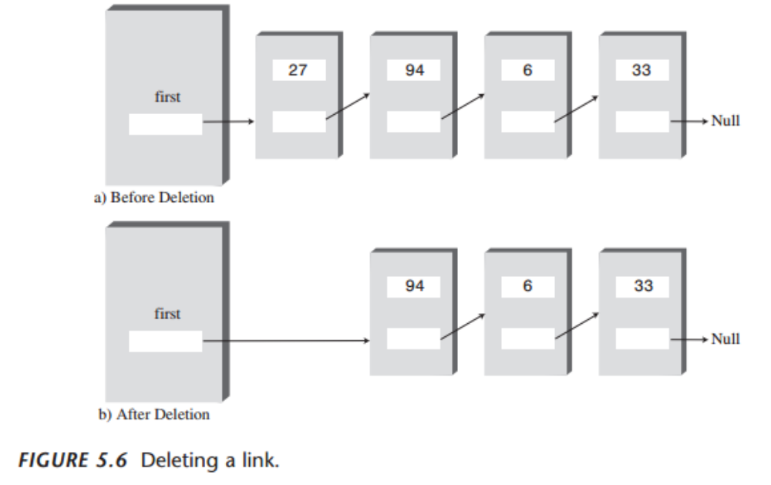
The delete
public Link deleteFirst() // delete first item
{ // (assumes list not empty)
Link temp = first; // save reference to link
first = first.next; // delete it: first-->old next
return temp; // return deleted link
}
Notes:
https://www.youtube.com/watch?v=3oR8owxaGkY

Slide 16
Find Method
public Link find(int key) // find link with given key
{ // (assumes non-empty list)
Link current = first; // start at ‘first’
while(current.iData != key) // while no match,
{
if(current.next == null) // if end of list,
return null; // didn’t find it
else // not end of list,
current = current.next; // go to next link
}
return current; // found it
}
Notes:
https://www.youtube.com/watch?v=feLNtgVg1xI

Slide 17
The display
public void displayList()
{
System.out.print(“List (first-->last): “);
Link current = first; // start at beginning of list
while(current != null) // until end of list,
{
current.displayLink(); // print data
current = current.next; // move to next link
}
System.out.println(“”);
}
Notes:
https://www.youtube.com/watch?v=NaZJ5fmzDhA

Slide 18
Summary
A linked list consists of one linkedList object and a number of link objects.
The linkedList object contains a reference, often called first, to the first link in the list.
Each link object contains data and a reference, often called next, to the next link in the list.
A next value of null signals the end of the list.

Slide 19
Summary
Inserting an item at the beginning of a linked list involves changing the new link's next. And field to point to the old first link, and changing first to point to the new item.
Deleting an item at the beginning of a list involves setting first to point to first.next.

Slide 20
Summary
To traverse a linked list, you start at first; then go from link to link, using each link's next field to find the next link.
A link with a specified key value can be found by traversing the list. Once found, an item can be displayed, deleted, or operated on in other ways.
A new link can be inserted before or after a link with a specified key value

Slide 21
summary
A double-ended list maintains a pointer to the last link in the list, often called last, as well as to the first.
A double-ended list allows insertion at the end of the list.
In a sorted linked list, the links are arranged in order of ascending (or sometimes descending) key value

Slide 22
Summary
Insertion in a sorted list takes O(N) time because the correct insertion point must be
found.
Deletion of the smallest link takes O(1) time.
In a doubly linked list, each link contains a reference to the previous link as well as the next link.
A doubly linked list permits backward traversal and deletion from the end of the list.

Slide 23
Lab exercises
Implement linked list that Implement certain operations on such as insert at first, insert any-where, delete-first, delete any-where, display and find

Slide 24
The End…
Thanks You & Have a Good Day

